Slide 1
CATIA V5R21 Persistent Naming
16-05-18
Soonjo Kwon
iCAD

Slide 2
Document History
16-05-18_Soonjo Kwon_Draft
16-10-11_Soonjo Kwon_r1

Slide 3
Table of Contents
CATIA Persistent Naming
Face Naming
Edge Naming
Key information
Sketch element
Naming mapping
Conclusion

Slide 4
CATIA Persistent Naming
CATIA uses topology-based persistent naming method
Face naming is the basis
Required Information for face naming
Face type (initial, lateral, terminal)
Feature name
Sketch name, Sketch element number
For edge or vertex, adjacent faces are used for naming
※ The following content is based on CATIA V5R21

Slide 5
Face Naming (1)
("Selection_RSur:( Face:(Brp:(Pad.1;2);None:();Cf11:()); Pad.1_ResultOUT;Z0;G4074)")
Face naming
Additional
Face naming
Key information
Recently created feature name

Slide 6
Face Naming (2)
("Selection_RSur:( Face:(Brp:(Pad.1;0:(Brp:(Sketch.1;4)));None:();Cf11:()); Pad.1_ResultOUT;Z0;G4074)")
Face naming
Additional
Face naming
Key information
Recently created feature name

Slide 7
Edge Naming (1)
("REdge:( Edge:( Face:(Brp:(Pad.1;0:(Brp:(Sketch.1;3)));None:();Cf11:()); Face:(Brp:(Pad.1;2);None:();Cf11:()); None:(Limits1:();Limits2:());Cf11:()); WithTemporaryBody;WithoutBuildError;WithSelectingFeatureSupport; MFBRepVersion_CXR15)", pad1)
edge
naming
First adjacent face naming
Second adjacent face naming
Additional
Edge naming
Face naming
Key information
Recently created feature name

Slide 8
Edge Naming (2)
("TgtEdge:(GeneratedEdges;MfIE_R20GA;TgtPropagationFillet; FirstOperands:(Pad.1);SecondOperands:();InitEdges:REdge:( Edge:( Face:(Brp:(Pad.1;0:(Brp:(Sketch.1;3)));None:();Cf11:()); Face:(Brp:(Pad.1;2);None:();Cf11:()); None:(Limits1:();Limits2:());Cf11:()); WithTemporaryBody;WithoutBuildError;WithSelectingFeatureSupport; MFBRepVersion_CXR15)))", pad1)
edge
naming
First adjacent face naming
Second adjacent face naming
Additional
Edge naming
Face naming
Key information
Recently created feature name
Feature name of the target body

Slide 9
Key information
(Pad.1;0:(Brp:(Sketch.1;3)))
Feature name
Face type
0 : lateral face
1 : initial (start) face
2 : terminal (end) face
Sketch information (In case of lateral faces)
Sketch name
Sketch element number (=ReportName)
(* Initial or terminal face requires no sketch information)
(** Need two sketch information for the features that require two sketches such as rib, slot)
(Rib.1;0:(Brp:(Sketch.1;4);Brp:(Sketch.2;3)))

Slide 10
Key information : Sketch element
ReportName is used to identify a sketch element
Dim line2D1 As Line2D
Set line2D1 = factory2D1.CreateLine(-20.000000, -20.000000, 20.000000, -20.000000)
line2D1.ReportName = 3
……
line2D2.ReportName = 4
……
line2D3.ReportName = 5
……
line2D4.ReportName = 6
An example of
CATIA macro
(Pad.1;2)
(Pad.1;0:(Brp:(Sketch.1;5)))
line2D3
(Pad.1;0:(Brp:(Sketch.1;6)))
(Pad.1;0:(Brp:(Sketch.1;4)))
Sketch.1
Create Pad.1
line2D4
line2D2
line2D1
(Pad.1;0:(Brp:(Sketch.1;3)))
(Pad.1;1)

Slide 11
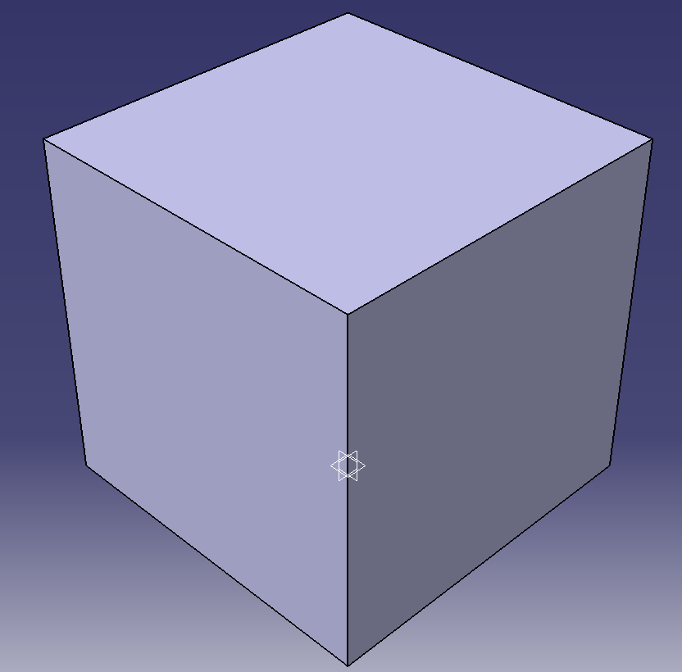

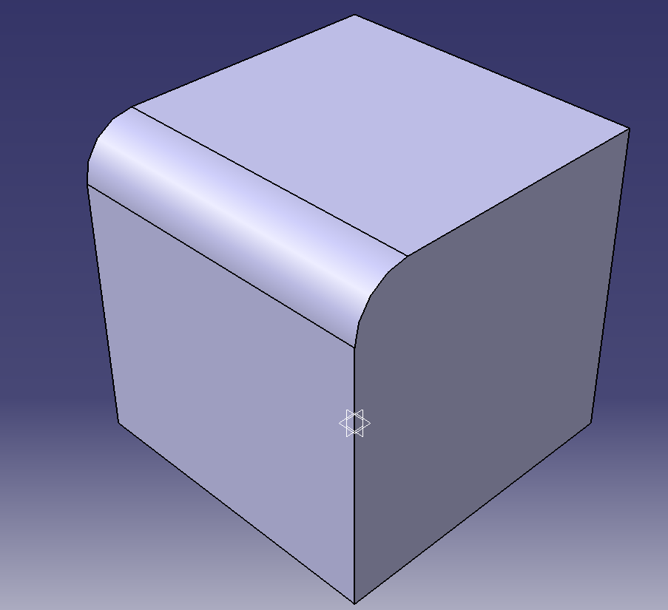
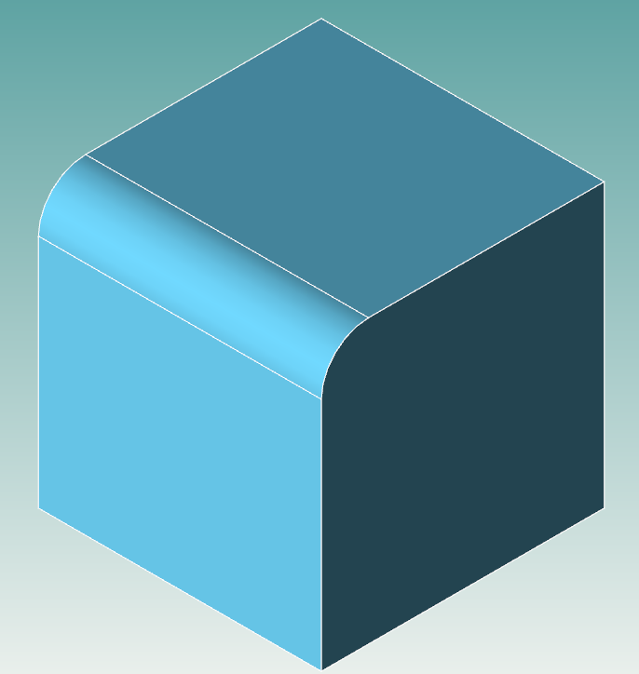
Naming mapping
Naming mapping is necessary for translating reference elements such as face, edge, vertex
CATIA
TransCAD
Select an edge
TgtEdge:(GeneratedEdges;MfIE_R20GA;TgtPropagationFillet; FirstOperands:(Pad.1);SecondOperands:();InitEdges:(REdge:( Edge:( Face:(Brp:(Pad.1;0:(Brp:(Sketch.1;3)));None:();Cf11:()); Face:(Brp:(Pad.1;2);None:();Cf11:()); None:(Limits1:();Limits2:());Cf11:()); WithTemporaryBody;WithoutBuildError; WithSelectingFeatureSupport;MFBRepVersion_CXR15)))
mapping
Extrude1,Sketch1,Line3,0,0,0,ExtrudeFeature:0,0:0;0#
Extrude1,0,-2,0,0,0,ExtrudeFeature:0,0:0;0
Create a fillet

Slide 12
Conclusion
CATIA is using topology-based persistent naming
Face naming is the basis
Key information: Feature name, Face type, Sketch information
Sketch information consists of sketch name & sketch element number
ReportName is used to identify a sketch element (=sketch element number)
To understand the persistent naming method is the key for implementation
Naming mapping between two CAD systems is mandatory for translation

Slide 13
Conclusion
Please check all the face names of all the additive/subtractive features in CATIA
Use macro recording function
The naming rule of TransCAD is almost similar with the naming rule of CATIA
The naming method is thought to be version-independent, but please check if the naming method is the same when you upgrade CATIA

